Slide 1
The Sparks Foundation (TSF)
Graduate Rotational Internship Program (GRIP)
Task #1
Exploratory Data Analysis (EDA)
Presented by: Ans Rehman

Slide 2
Assigned Tasks:
Perform 'Exploratory Data Analysis' on dataset 'Sample Superstore’
As a business manager, try to find out the weak areas where you can work to make more profit.
What all business problems you can derive by exploring the data? You can choose any of the tool of your choice (Python/R/Tableau/PowerBI/Excel/SAP/SAS)

Slide 3
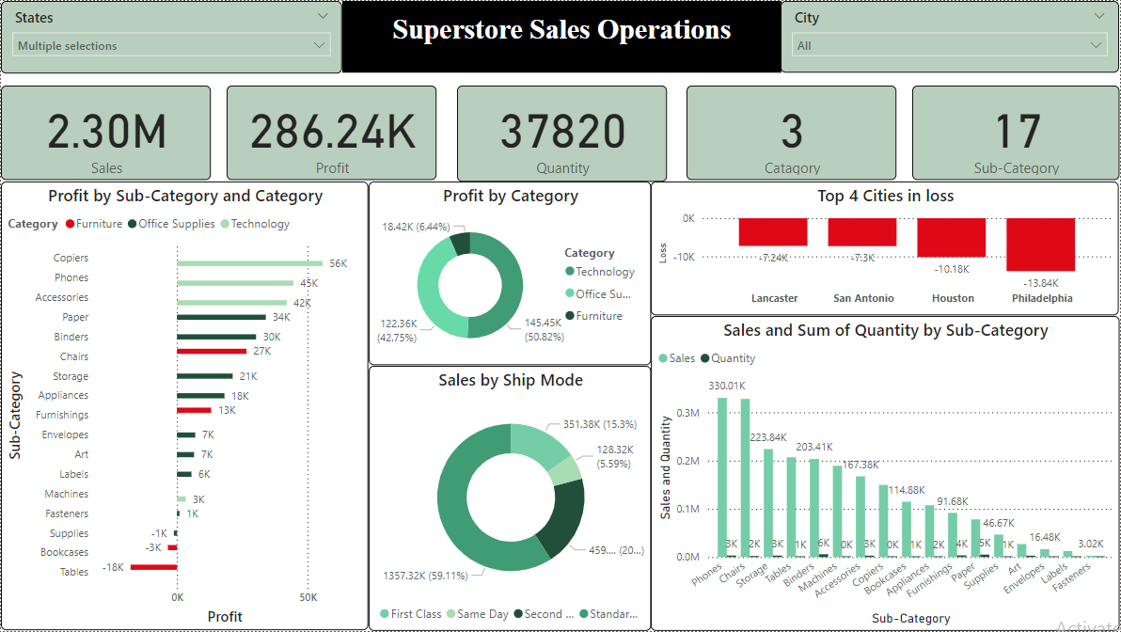

Slide 4
Key Findings:
Furniture category generated the least profit, with subcategories Bookcases and Tables experiencing losses of $3.5k and $17.3k, respectively.
Significant sales losses were recorded in the cities of Philadelphia ($13.8k), Houston ($10.1k), San Antonio ($7.3k), and Lancaster ($7.24k). Additionally, the 'Supplies' subcategory within 'Office Supplies' incurred a loss of $1.15k.
In the top loss cities, even the best-selling products underperformed, generating low overall sales and contributing to the overall losses.

Slide 5
Proposed solutions:
Revise Strategies for Loss-Making Categories:
--- Analyze and address issues in the Furniture category, especially Bookcases and Tables. Adjust pricing, reduce inventory, or discontinue underperforming products. Implement targeted marketing campaigns to boost sales
Focus on High-Performance Products and Cities:
--- Invest more in the Technology category. Replicate successful strategies from high profit cities in underperforming ones. Tailor marketing efforts to address specific needs in top-loss cities, offering promotions or discounts.
Enhance Data-Driven Decision Making:
--- Use advanced analytics to monitor sales performance and detect underperformance early. Develop predictive models for accurate demand forecasting. Gather customer and employee feedback to inform product offerings and operational improvements.

Slide 6
Thank You!
Presented by: Ans Rehman

